Slide 1
Time Management as a great Challenge especially to students
By
Mubarak Muhammad Aliyu
Bsc. Agriculture
Alexandria University
Egypt.
21/9/2013

Slide 2
Topics of Discussion
How do I start managing my time
What is so essential to time management
How do I keep on track
My advice to You

Slide 3
It is really a great challenge

Slide 4
How do I start managing my time
Goal Setting

Slide 5
Goal setting

Slide 6
Goal setting
Write them down
Review them on regular basis
You can always change and adjust your plans

Slide 7
Use the a simple trick called
The SMART System
When you think of goal setting, the SMART system is very easy, realistic and gets the task done.
S – Specific M – Measurable A – Achievable R – Realistic T – Timely

Slide 9
What is so essential to time management
Self descipline

Slide 10
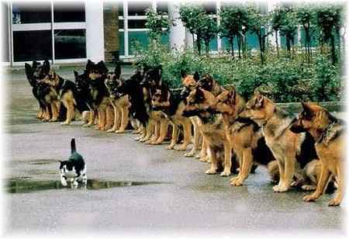

Slide 11
Self Descipline
Self-discipline is
taking control of your
life in order to
achieve a desired
future.

Slide 12
Self Descipline
Discipline is voluntarily enduring temporary discomfort for greater gain in the future.
Discipline ensures what you do when no one is looking.

Slide 13
Some simple steps
Talk to your self
Start small by small
Once you make the decision to do something, follow through no matter what
Once you learn to do something correctly, keep doing it
Never procrastinate

Slide 14
How do I keep on track
Motivation

Slide 16
It is the process that initiates, guides and maintains goal-oriented behaviors.

Slide 17
Some simple ways to be motivated
Reading history
Reading recent achievements
Challenging oneself

Slide 18
Videos

Slide 19
My advice

Slide 21
References
http://www.notorious-rob.com/2013/06/17/concerning-a-challenge-for-positive-change-a-few-thoughts/
http://366pi.com/goal-setting-its-common-sense-not-dogs-run/
http://www.latestcrunchs.com/a-simple-guide-to-goal-setting/
http://pastorscottie.wordpress.com/category/self-discipline/
http://mysuccessprinciples.com/general/following-through-how-to-increase-self-discipline/
http://expertenough.com/2319/self-discipline
http://tapiture.com/image/inspirational_quotes_of_famous_people_640_01
http://www.wikihow.com/Bring-Discipline-in-Life
http://psychology.about.com/od/mindex/g/motivation-definition.htm

Slide 22
Thank You

