Slide 1
Generate Electricity from solar energy

Slide 2
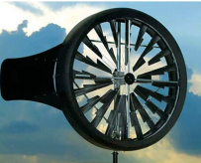
content
Review
Method of renewable energy
Generation in Egypt
Solar energy application
Concentrated solar power (CSP)
Photovoltaic(PV)
Heating by the sun
Water desalination

Slide 3
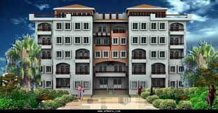
Review
Load KWh
Load MWh
All Load GP
Load GWh

Slide 4
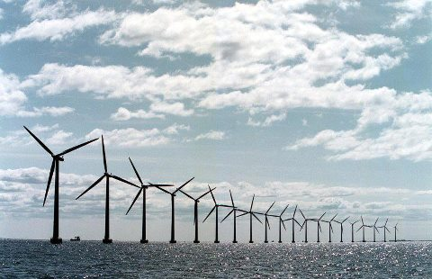
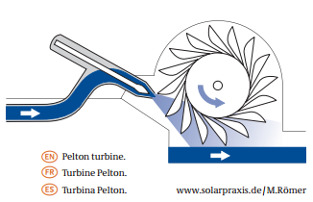
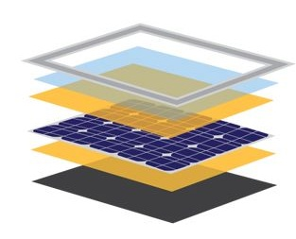
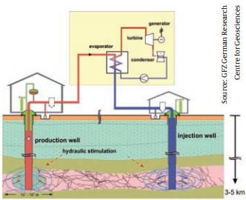
Method of renewable energy
Wind Energy
Hydropower
Geothermal Energy
Photovoltaic

Slide 5
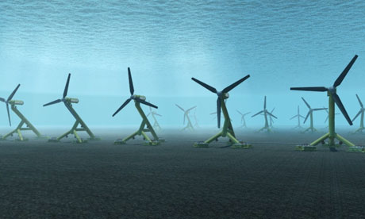
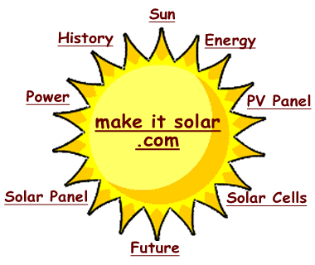
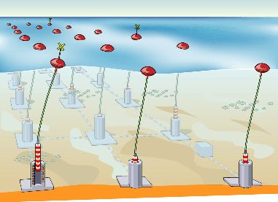
Method of renewable energy
Tidal energy
Wave power
Solar thermal Energy

Slide 6
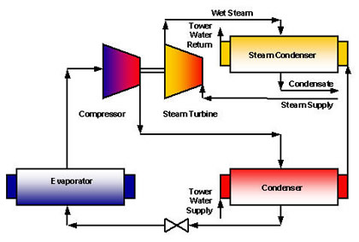
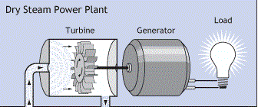
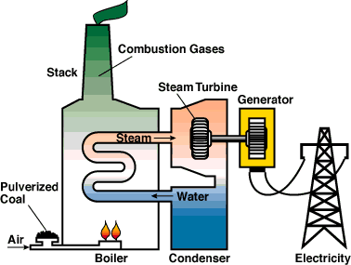
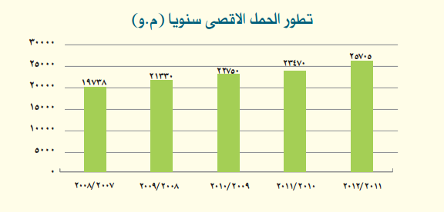
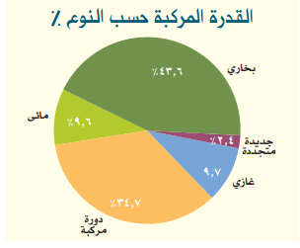
Generation in Egypt

Slide 7
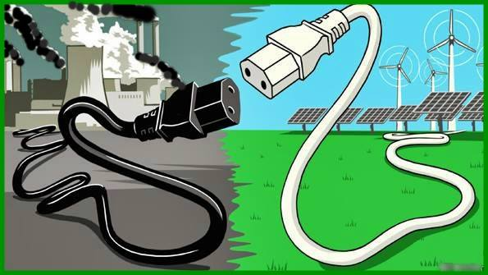
Which Power you want? Non polluting Green Power is the best!!!

Slide 8
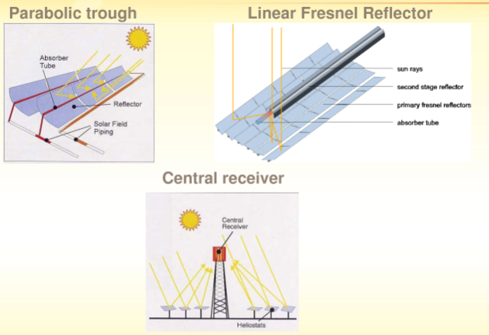
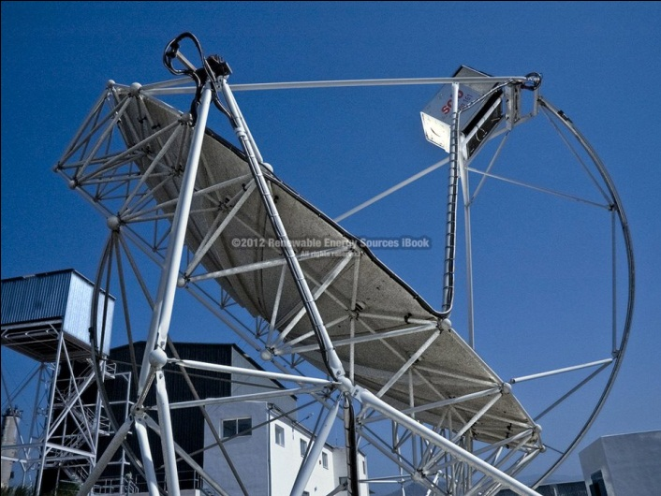
Solar thermal power plant(CSP)

Slide 9
Solar thermal power plant(CSP)
1-parabolic trough
The solar field of a parabolic trough power plant consists of numerous parallel rows of collectors, which are made of parabolic reflectors. These concentrate the sunlight onto an absorber tube that runs along the focal line, generating temperatures of
approximately 400 °C. Circulating thermo-oil serves as a heat transfer medium to conduct the thermal energy to a heat exchanger, where water vapor is generated with a temperature of around 390 °C. This is then used to power a steam turbine and generator,
the same as in conventional power plants. since produced more than 16,000 Giga watt

Slide 10
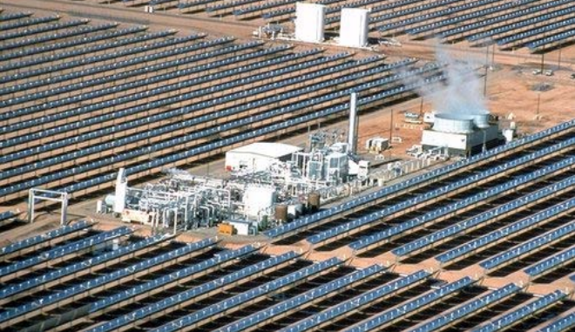
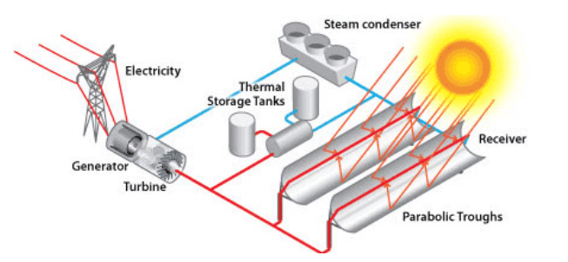
1-parabolic trough

Slide 11
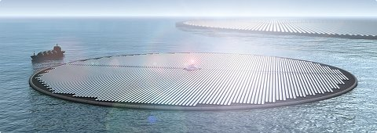
1- parabolic trough
A magic location Switzerland

Slide 12
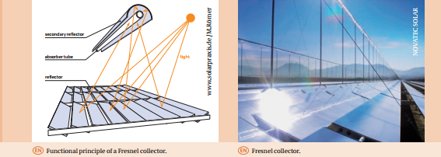
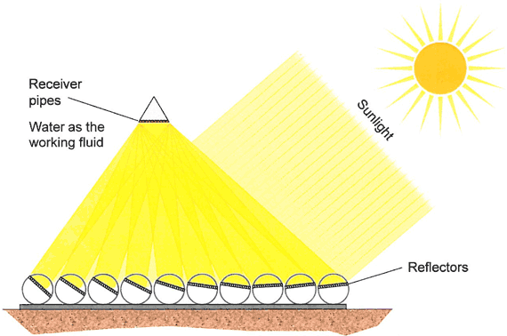
Solar thermal power plant(CSP)
2- Fresnel collectors
Fresnel collectors are also undergoing practical trials. With these collectors, long, only slightly curved reflectors concentrate the solar radiation onto a fixed absorber tube, where
water is directly heated and vaporized. As the basic concept of these collectors is simpler in comparison to parabolic troughs, lower investment costs for the reflectors can be expected. However, the comparable annual efficiency will be somewhat lower.

Slide 13
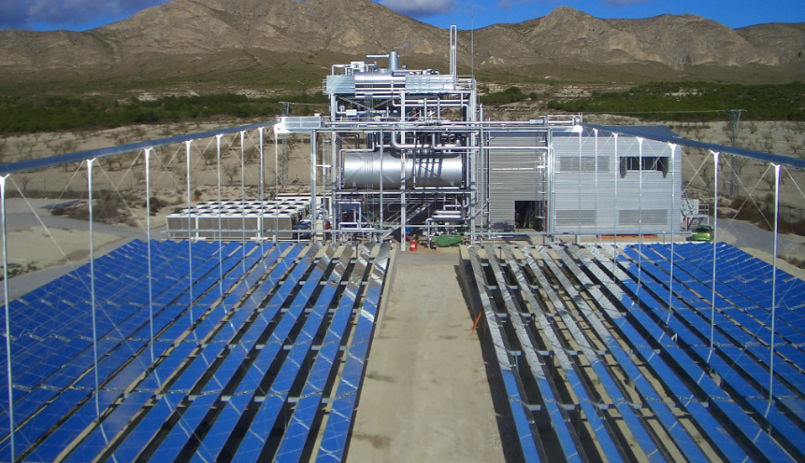
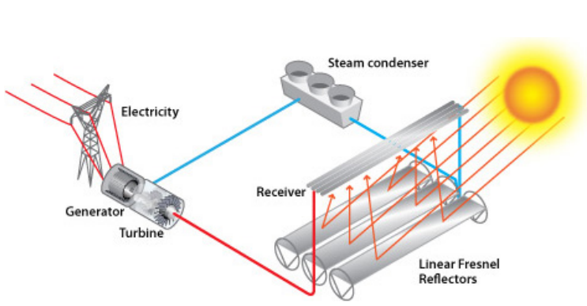
2- Fresnel collectors

Slide 14
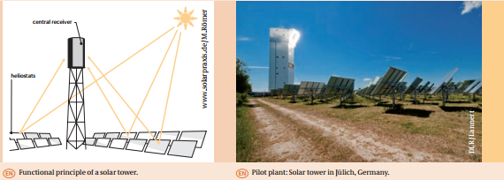
Solar thermal power plant(CSP)
3- solar tower power plants
In solar tower power plants solar radiation is concentrated onto a central heat exchanger /
absorber by hundreds of automatically positioned reflectors. The significantly higher concentration in comparison to parabolic trough collectors, for example, allows higher temperatures in excess of 1,000 °C to be achieved. This enables greater efficiency, particularly when using gas-powered turbines, thereby resulting in lower electricity costs

Slide 15
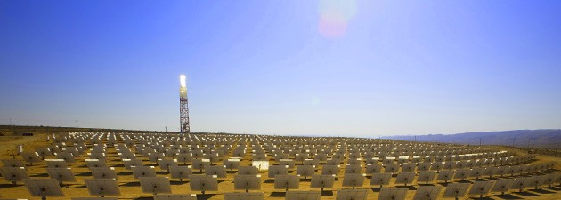
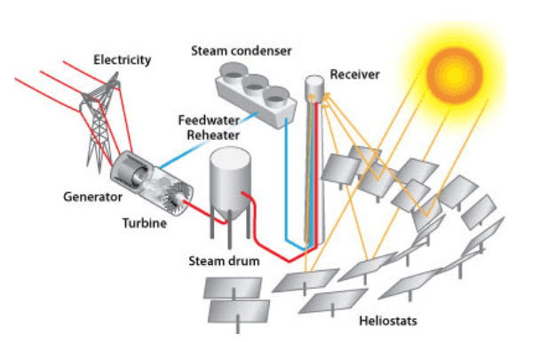
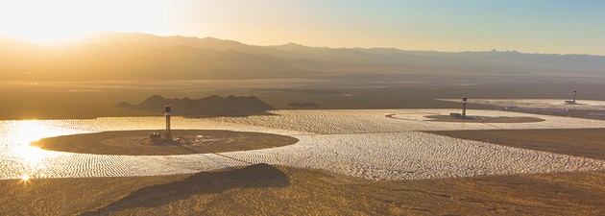
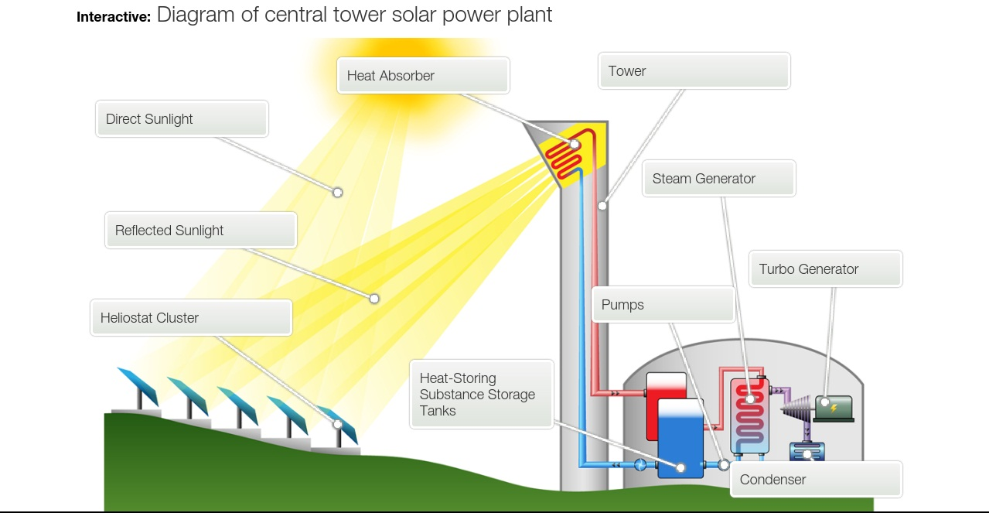
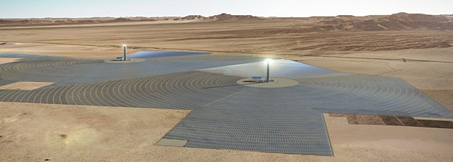
3- solar tower power plants

Slide 16
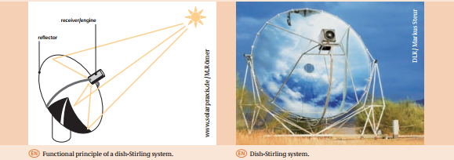
Solar thermal power plant(CSP)
4- Dish-Stirling machine
a parabolic reflector mirror concentrates the solar radiation onto the receiver of a connected Stirling engine. The engine then converts the thermal energy
directly into mechanical work or electricity. These systems can achieve a degree of efficiency in excess of 30 %. Prototype systems are undergoing trials at the Platform Solar center in Almeria, Spain. Although these systems are suitable for stand-alone operation, they also offer the possibility of interconnecting several individual systems to create a solar farm, thus meeting an electricity demand from ten kW to several MW.

Slide 17
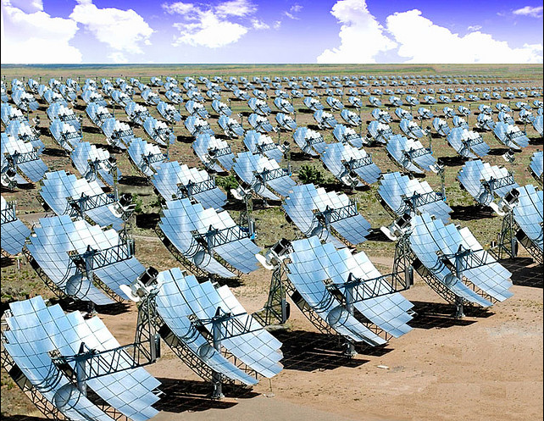
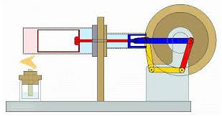
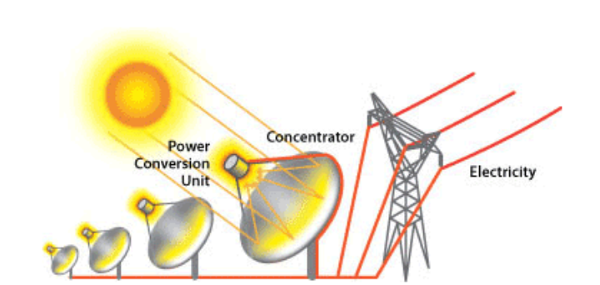
Dish-Stirling machine

Slide 18
End of session
Facebook: www.facebook.com/abdo.fargly Email: abdo_fargly@yahoo.com
Edit by Eng. Abdelrahman Mohamed fargly

Slide 19
Question and discussion
Facebook: www.facebook.com/abdo.fargly Email: abdo_fargly@yahoo.com
Edit by Eng. Abdelrahman Mohamed fargly

