Slide 1
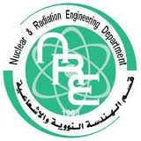
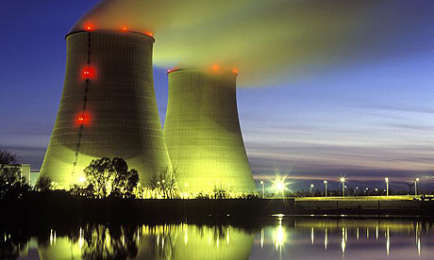
Electricity Generation from nuclear Energy
Shymaa Ali Alshater
E-Mail : Shymaa_Ali_2020@Yahoo.com

Slide 2
Objectives
Learning some new terminologies related to nuclear energy.
Take a look to the different types of reactors.
Understanding how to produce electricity from nuclear power plant.

Slide 3
Important definitions
Isotopes
Atoms of the same element that have the same number of protons but a different number of neutrons in the nucleus.
Radioisotope
Atoms want to be stable by making the no. of protons equal to the no. of neutrons by ejection of neutrons ,(All elements with atomic no. greater than 83).

Slide 4
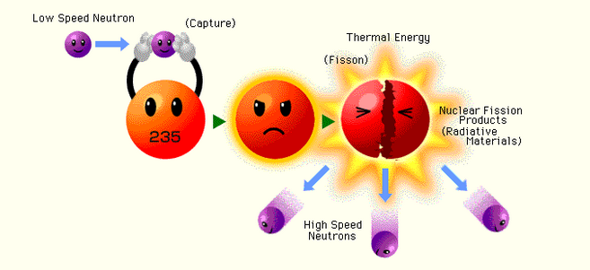
Important definitions ( Cont.)
Fission reaction

Slide 5
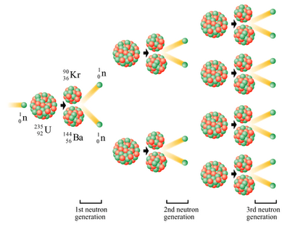
Important definitions ( Cont.)
Fission chain reaction

Slide 6
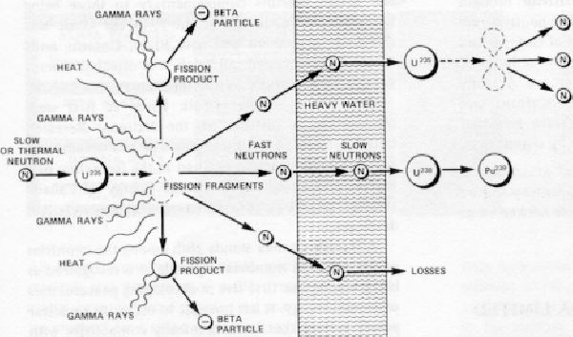
Important definitions ( Cont.)
Fission reaction

Slide 7
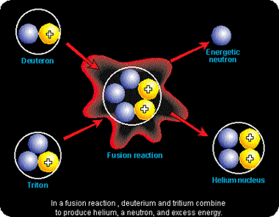
Important definitions ( Cont.)
fusion reaction

Slide 8
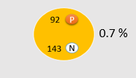
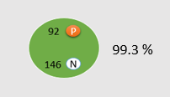
Important definitions
Fertile Material
Fissionable Material
Enrichment
U 235
U 238

Slide 9
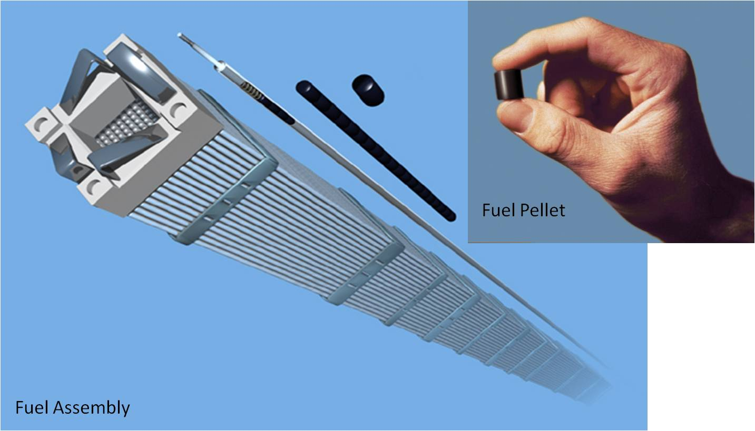
Fuel Assembly

Slide 10
Energy Equivalents
10

Slide 11
Types of reactors
Light water reactor
Heavy water reactor
Gas/Graphite cooled reactors
Water/Graphite reactors
Pressurized water reactor
Boiling water reactor
11

Slide 12
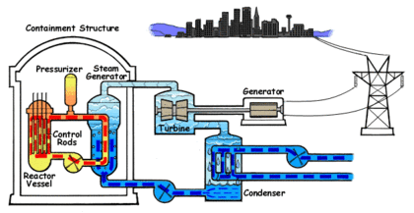
Pressurized water reactor
12

Slide 13
Boiling water reactor

Slide 14
Useful book in Arabic
الثقافة النووية للقرن 21
ما يجب ان نعرفة عن أساسيات التكنولوجيا النووية
تأليف: د.ممدوح عبدالغفور حسن
استاذ متفرغ بهيئة المواد النووية
رئيس الهيئة الاسبق
الطبعة الاولى
2000م
دار الفكر العربي
94 شارع عباس العقاد – مدينة نصر – القاهرة
ت : 2752984
فاكس : 2752735

