Slide 1
ETHICS in research
Eman raouf
Faculty of science
biochemistry2012

Slide 2
The content
Introduction (ethics)
Ethics in research
Ethics with animals
Ethics in genetics and labs
Citation of thesis
Useful web sites

Slide 3
important
Ethical issues

Slide 4
From school –to university !!!

Slide 5
why other countries successes in scientific research?

Slide 6
Code of ethics science web site for staff and students

Slide 7
http://www.ru.nl/masters/programme/medical-sciences/bioethics/

Slide 8
The story
The Nazi euthanasia project
Reduce death
-human rights

Slide 9
Code of conduct for scientist
UNESCO 1999
Ethics in science should be integral part of education
Encourage young scientists

Slide 10
A new European Code of Conduct for Research Integrity
"Science is an international enterprise with researchers continually working with colleagues in other countries.”

Slide 11
A Code of Conduct for Biological Scientists:
Reduce risk
Decrease using of bombs
raising awareness

Slide 12
scientific misconduct
fabrication
falsification
cheating

Slide 13
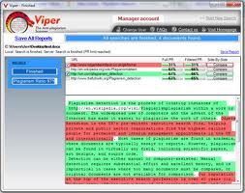
Plagiarism (cheating)in research

Slide 14
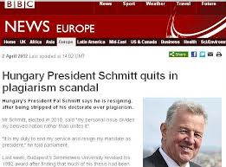
Notes:
رئيس دولة المجر

Slide 15
Consequences if misconduct is substantiated
Withdrawal from published papers
The end
Salary reduction
Of your
Restitution of funds
Research career!!

Slide 16
Citation of your research
To add credibility to your work

Slide 17
Citation management software

Slide 18
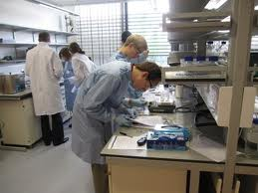
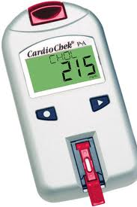
(Ethics in lab –(analysis

Slide 19
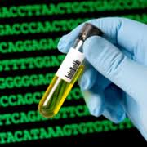
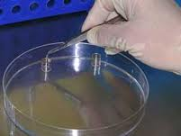

Slide 20
Ethics with patients during practice
In 1947 Nuremberg code established a new standard of medical behavior (voluntary informed consent )of the human.
Animal experiments should precede human experiment.
On the physicians 'part doctors should avoid actions that injure human patients.
Participants should always be at liberty to with draw from experiments.

Slide 21
Ethics of research on animals
Russel and burch (1959)
Minimize animal pain
Minimize the number of animal used
Replacement: avoiding the use of animals in experiments

Slide 22
Animal procedures committee report on biotechnology (June 2001)
Duplication of favorite pets
Genetic modified animals that would suffer severe or lasting illness
Dollie (the sheep)
Was cloned(1996)

Slide 23
Why ethics are important in genetics?
*we must be clear with patients
*patients have the right to control the use of all medical information about themselves, including genetic information

Slide 24
values(genetics)
Genetic privacy
Obligation to don’t harm
Respect for cultural and religious differences

Slide 25
Ethical guideline for genetic screening and testing
*genetic screening and testing should be voluntary
*results should not be disclosed to employers, insurers ,or others without individual’s consent
*new born screening should be mandatory and free of charge if early diagnosis and treatment will benefit the new born

Slide 26
The American society of human genetics
(disclosure and confidentiality)
The patient refuses the professional’s urging to warn the relatives.
Only the information necessary to prevent or treat inheritable disease is disclosed

Slide 27
Informed consent
Before genetic test are conducted
Screening
Treatment
(definition):make certain that people understand possible effects of procedures and that they are willing to undergo these procedure)

Slide 28
Ethical guide line for access to banked DNA
Informed consent (use sample in future)
If person died don’t use his DNA
DNA should be stored

Slide 29
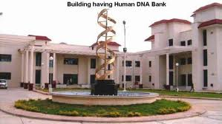
Notes:
Gene therapy

Slide 30
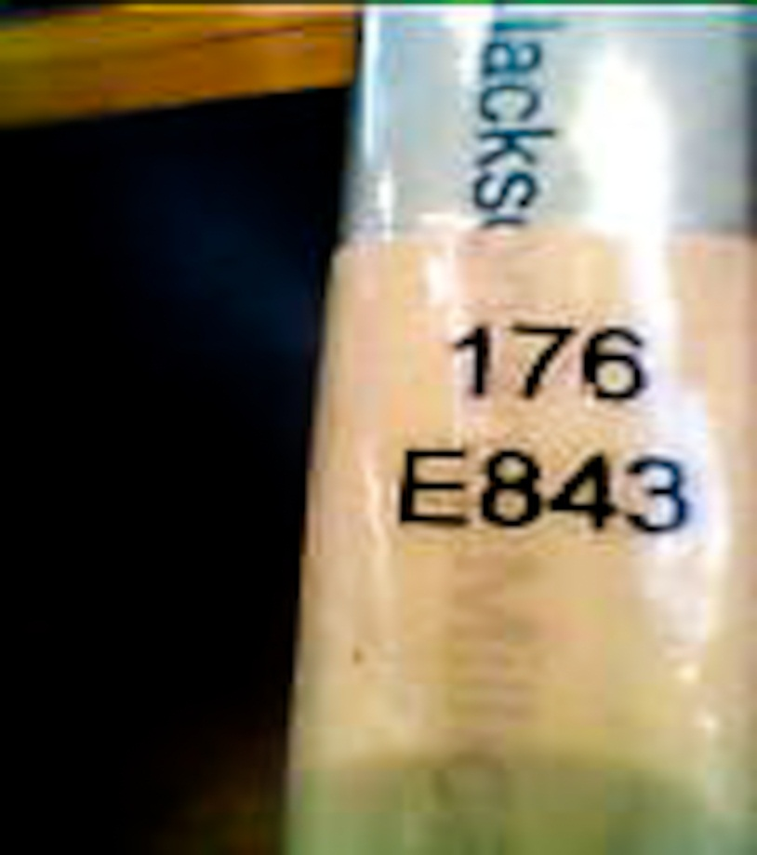
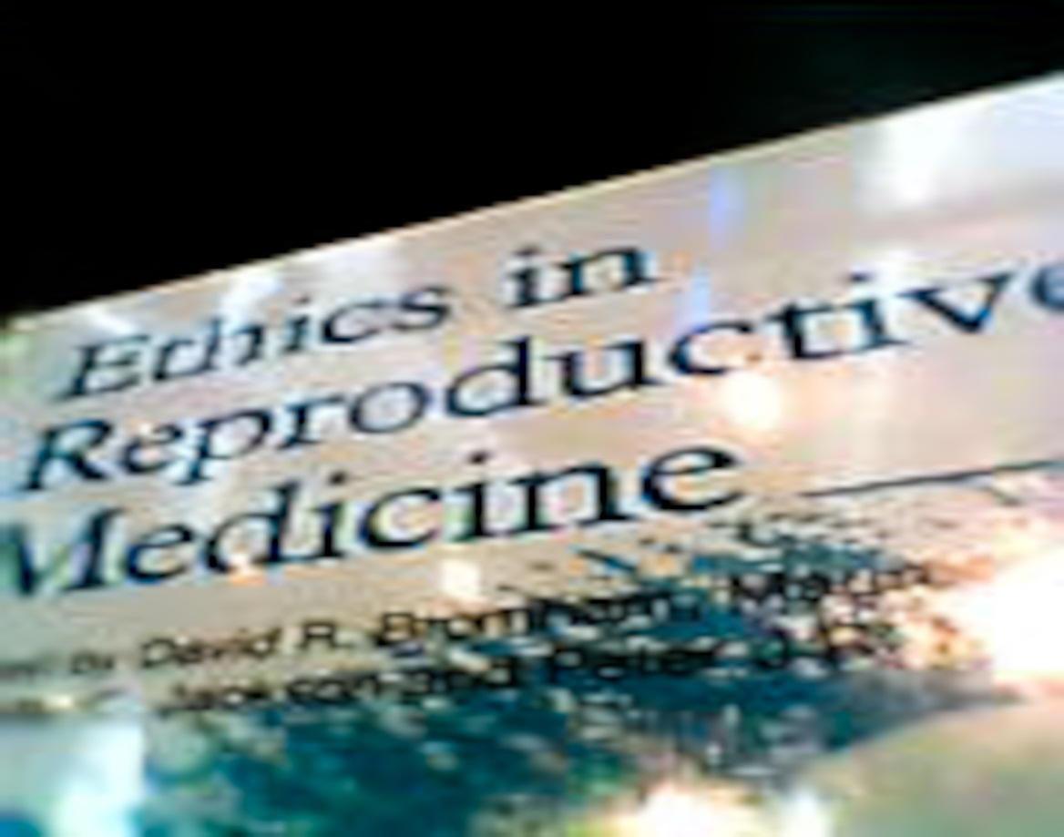
Suggestion book to read
B4 bibliotheca Alexandria

Slide 31
Finally: Useful websites
www.eul.edu.eg
Ebrary
Encyclopedia britannica
Springer link
Jstore
Science direct
Scopus
Medical databases (medline,dynamed,embase and smart image database)

Slide 32
references
Web sites
1-http://www.nap.edu/openbook.php?record_id=4917&page=3
2-http://www.unesco.org/new/en/social-and-human-sciences/themes/bioethics/
3-ttp://www.chicagomanualofstyle.org/tools_citationguide.html
4-http://www.sciencedaily.com/releases/2010/07/100721194803.htm-
5-http://www.esf.org/activities/mo-fora/research-integrity.html
6-http://www.absa.org/abj/abj/061101johnson.pdf
http://www.acog.org/Resources%20And%20Publications/Committee%20Opinions/Committee%20on%20Ethics/Ethical%20Issues%20in%20Genetic%20Testing.aspx-
Lectures:
Lectures by prof.Dr.wael M.lotfy in medical research institute

