Slide 1
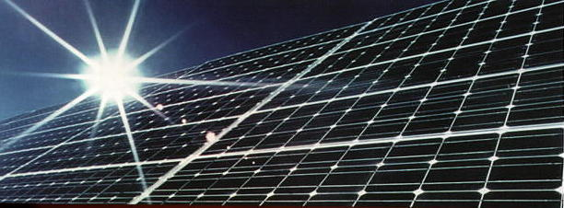
photovoltaic

Slide 2
content
Review
introduction
Technology
application

Slide 3
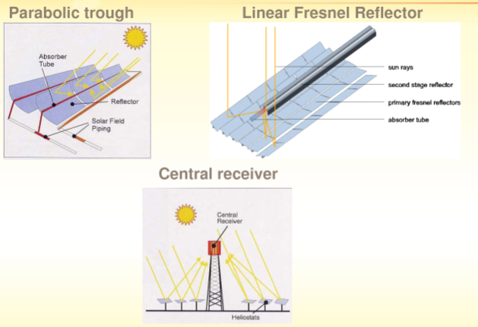
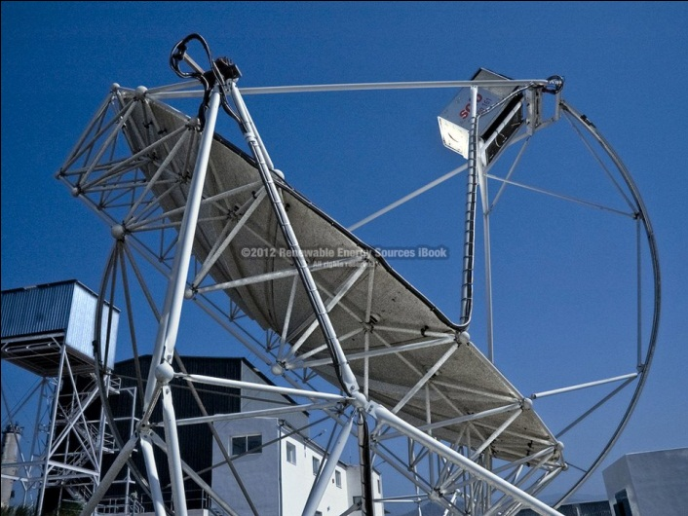
Solar thermal review

Slide 4
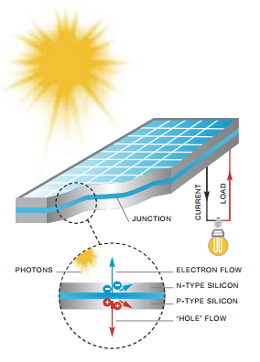
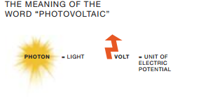
introduction
What does photovoltaic mean?
Photovoltaic systems contain cells that convert
sunlight into electricity. Inside each cell there are
layers of a semi-conducting material. Light falling on the cell creates an electric field across the layers, causing electricity to flow. The intensity of the light determines the amount of electrical power each cell generates.
A photovoltaic system does not need bright sunlight in order to operate. It can also generate electricity on cloudy and rainy days from reflected sunlight.

Slide 5
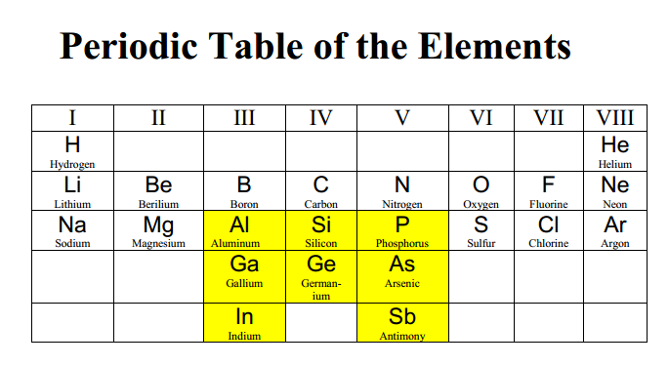
Solar panel source

Slide 6
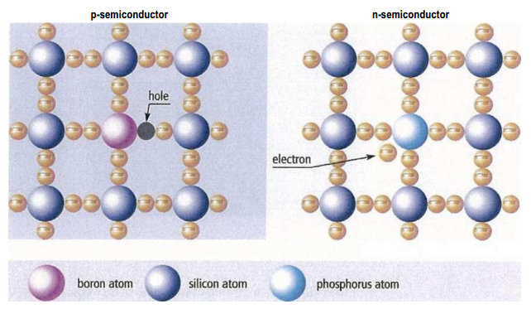
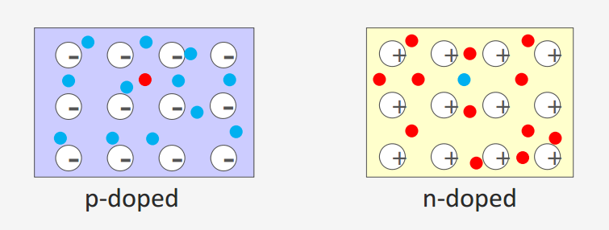
construction

Slide 7
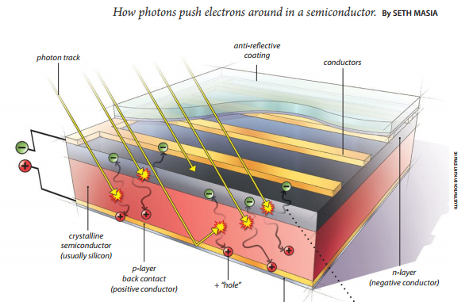
Single junction PV

Slide 8
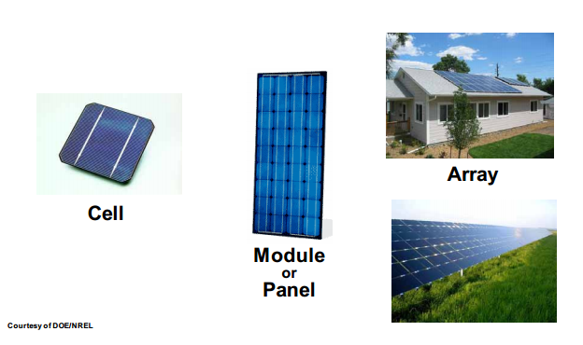
Solar panel source

Slide 9
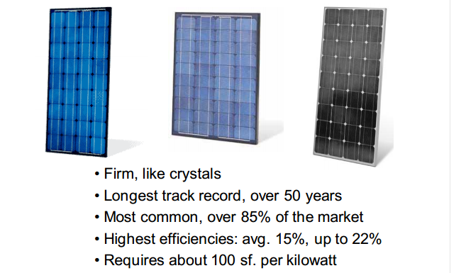
Crystalline Silicon PV Products

Slide 10
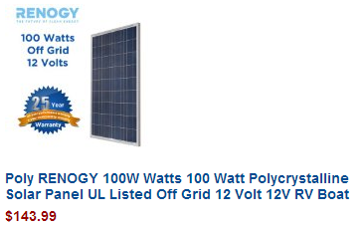
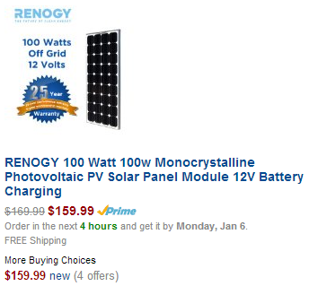
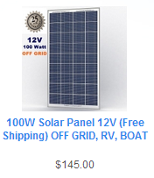
cost
EBay website: polycrystalline 130 up to 140 dollar
Alibaba website: polycrystalline 125 up to 150 dollar
Egypt distributer:
1500 L.E from abroad
1200 L.E collect in Egypt
This picture above from amazon website

Slide 11
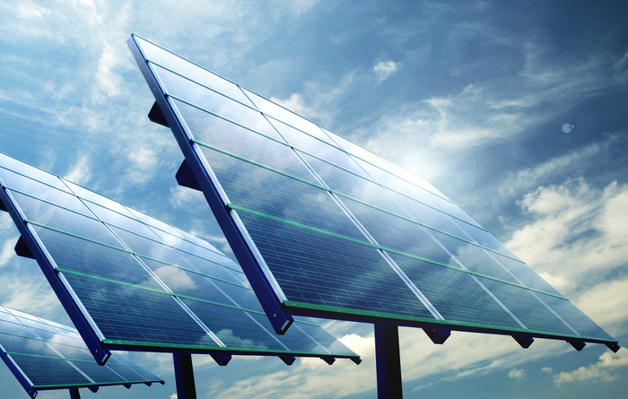
Photovoltaic technology

Slide 12
Muti-junction that the target
Single-junction solar cell Efficiency 15% up to 22%
Two-Junction Solar Cell Efficiency 30.8%
Triple-Junction Solar Cell Efficiency 44.4%
Fourth-junction solar cell Efficiency higher 44%
Multi-junction solar cell Efficiency 50 up to 60%

Slide 13
Infrared Solar Energy

Slide 14
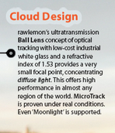
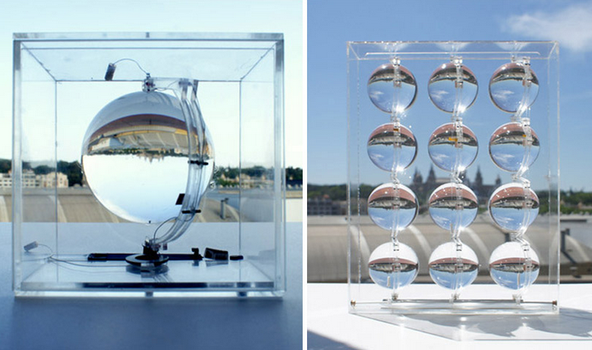
Generate electricity from light of the moon
Raw lemon's Spherical Solar Energy-Generating Globes Can Even Harvest Energy from Moonlight

Slide 15
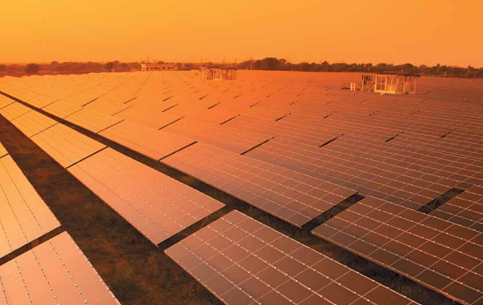
Music May Make Solar Cells More Efficient
A study at Queen Mary University of London and Imperial College London (both UK) investigated how ambient sound vibrations can enhance the performance of a printed solar cell with zinc-oxide (ZnO)
why does pop and rock music boost energy generation in these d solar cells mores than classical music? "The nanorods in the cells respond most strongly to 10 kHz sounds,

Slide 16
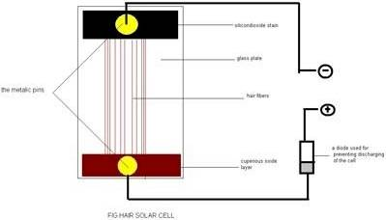
Human Hair Solar Panel by Milan Karki
18-year old Inventor, Milan Karki, from rural Nepal, claims to have come up with a new type of solar panel that uses human hair, a design he thinks could provide the developing world with cheap, green electricity. He has built several prototypes
His panel, which produces 18 Watts (9 volts at 2 amps)
probably the main one is that human hair does not conduct electricity but it can conduct an electric current.

Slide 17
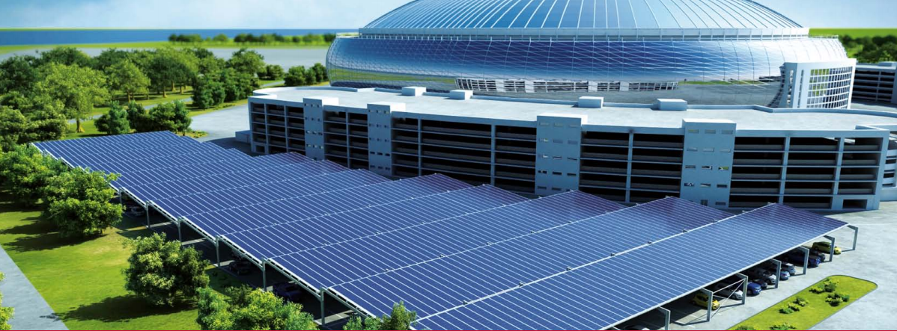
Photovoltaic application

Slide 18
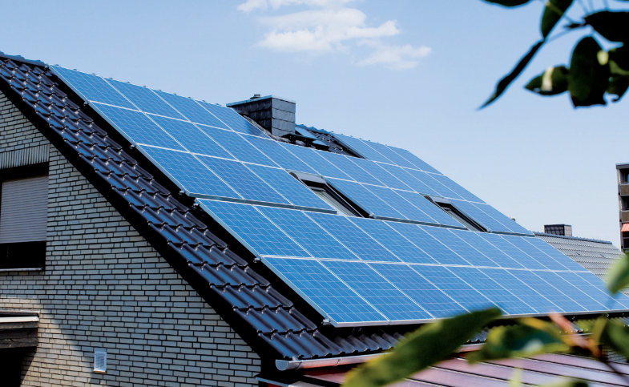
Residential

Slide 19
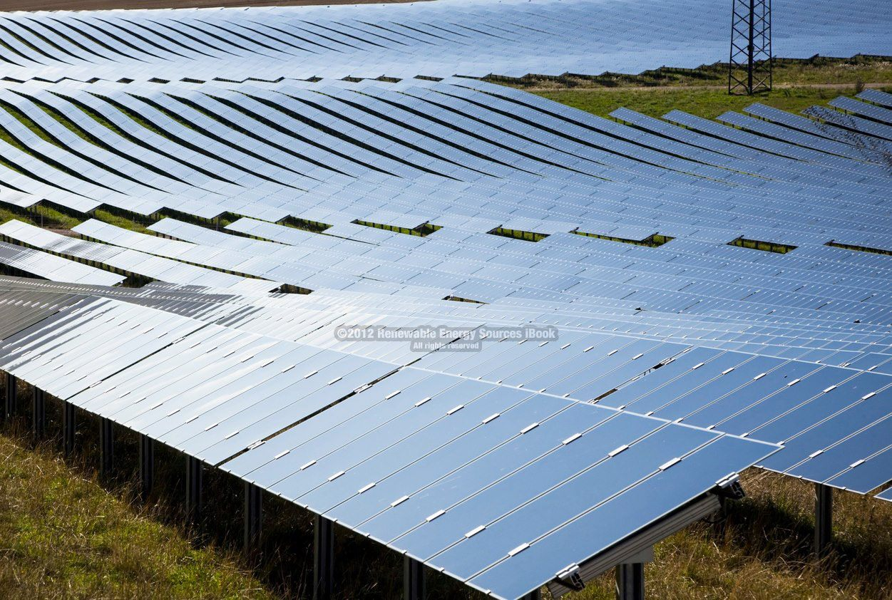
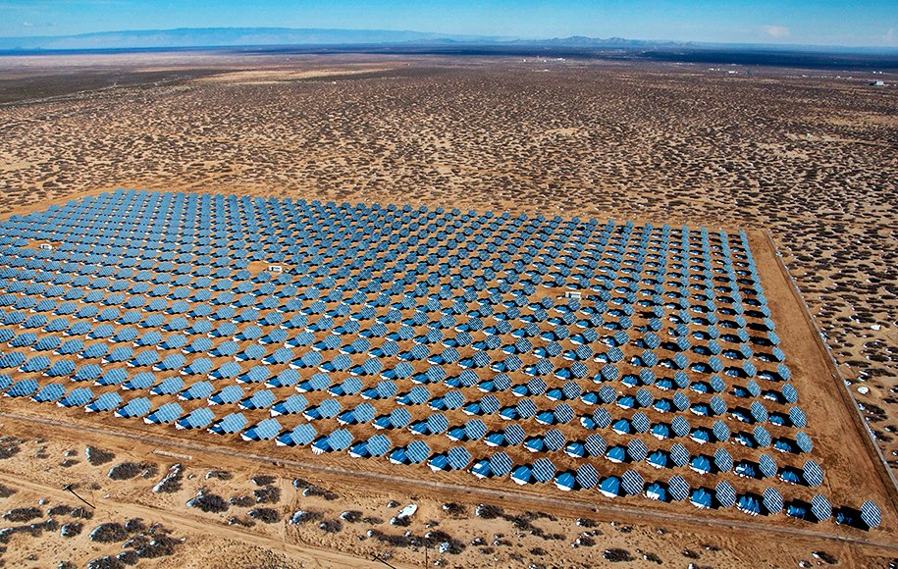
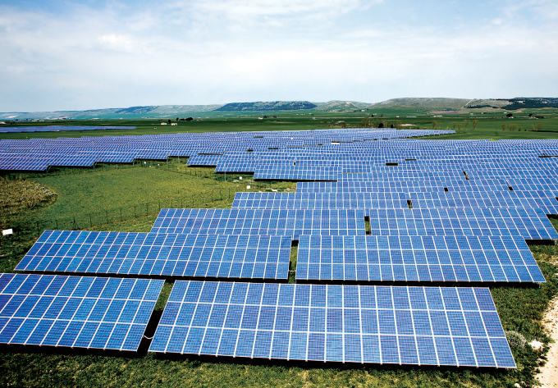
Electrical plant

Slide 20
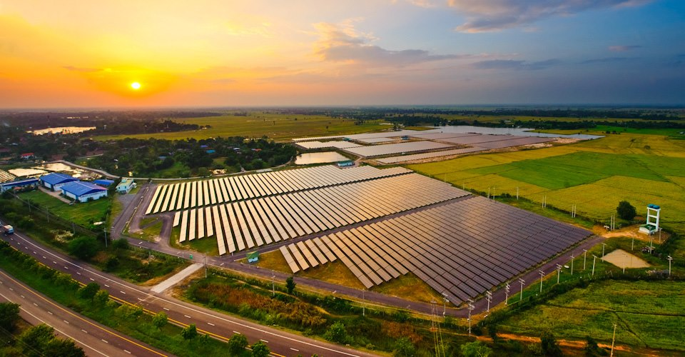
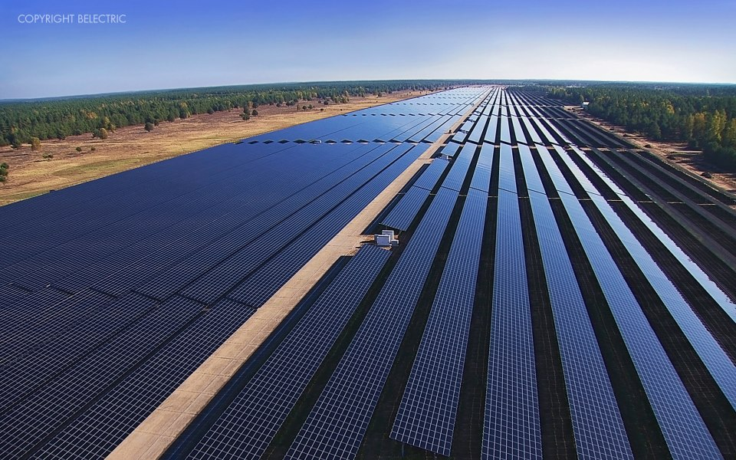
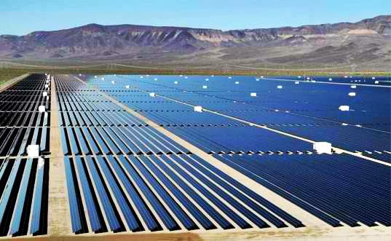
Electrical plant ( more )

Slide 21
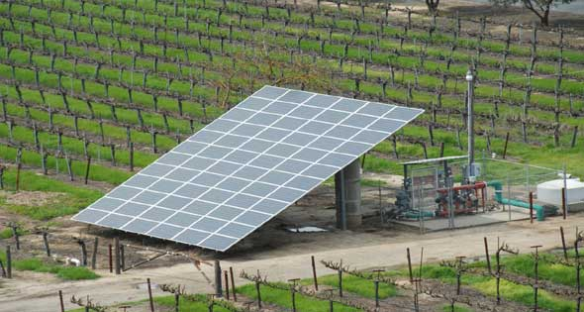
Agriculture application

Slide 22
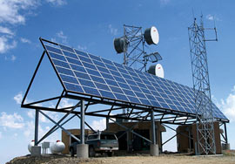
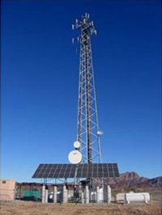
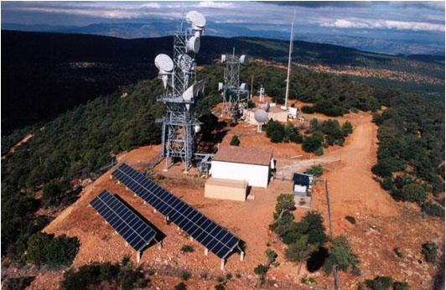
Tele-communication system

Slide 23
Hospital with PV

Slide 24
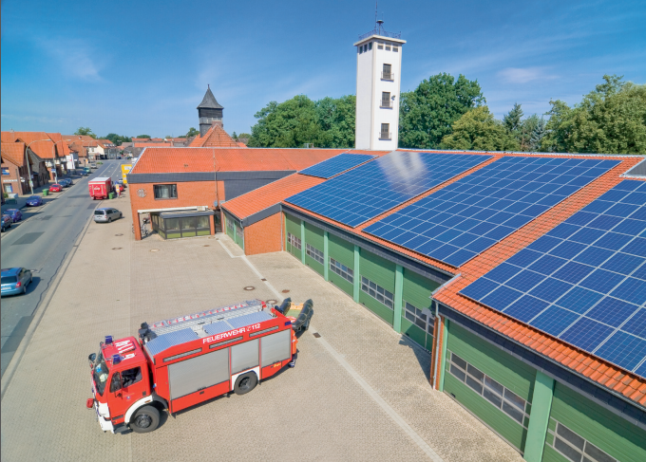
Fire station ( Germany)

Slide 25
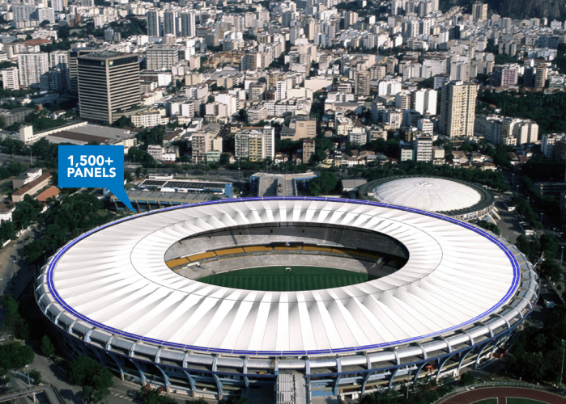
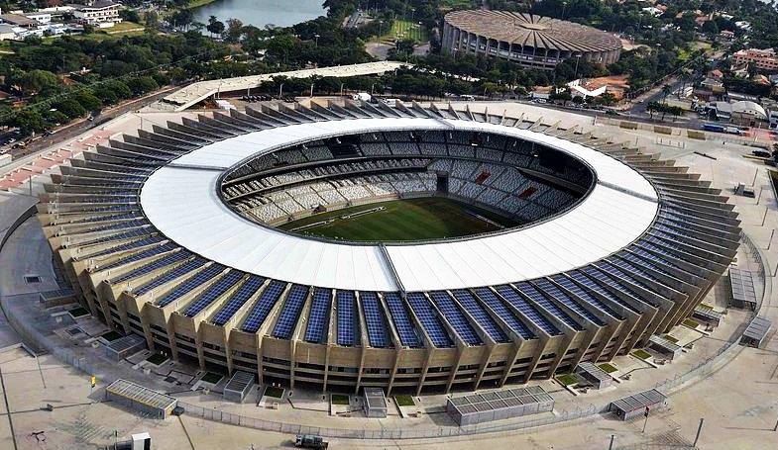
Stadium ( Brazil )

Slide 26
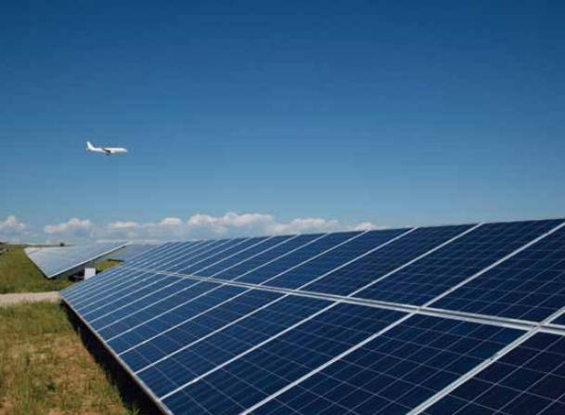
Airport (Denver, Colorado)

Slide 27
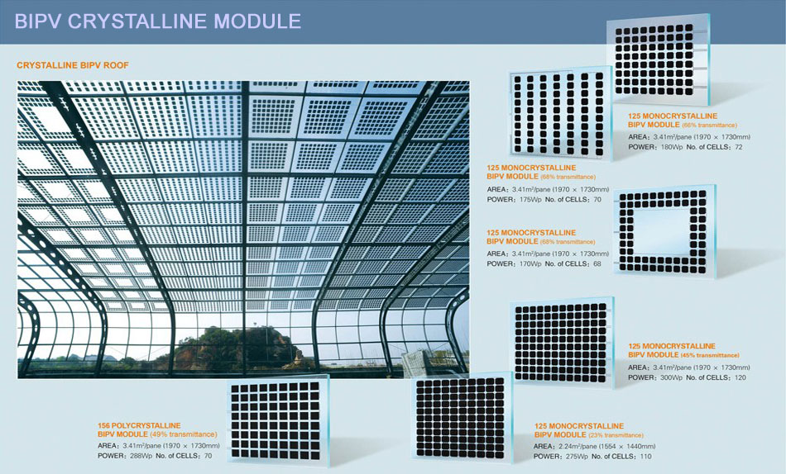
Building integrated PV

Slide 28
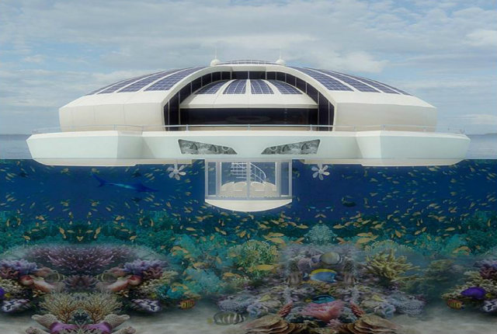
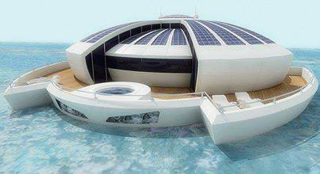
Solar float resort with PV

Slide 29
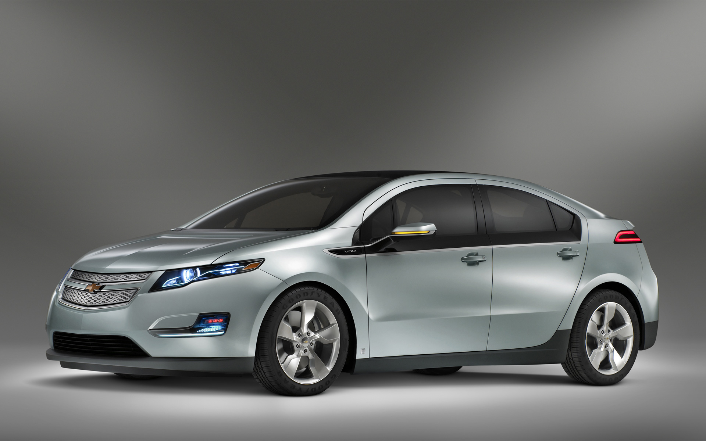
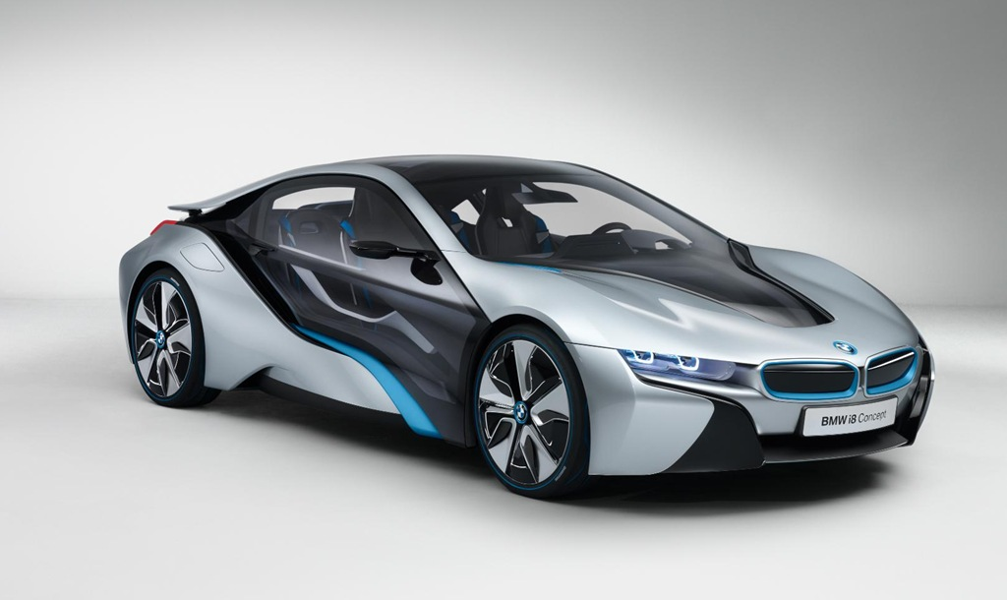
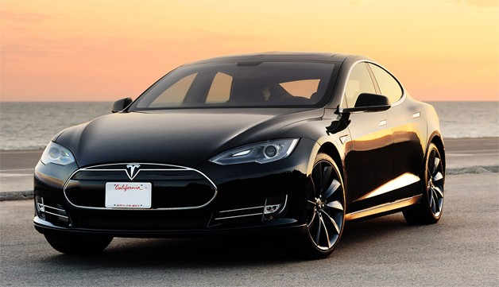
Electric car

Slide 30
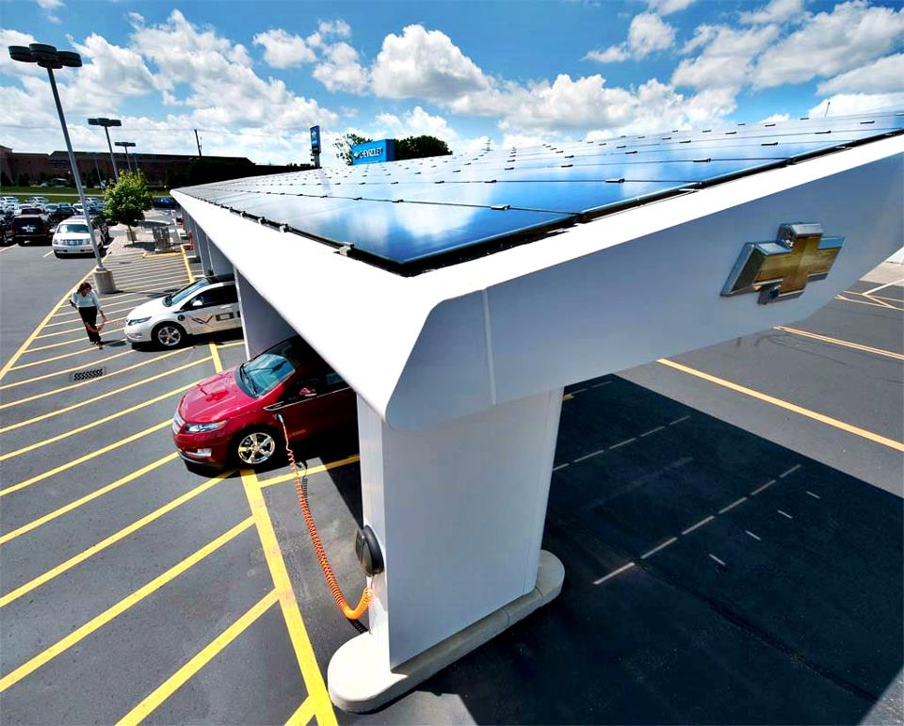
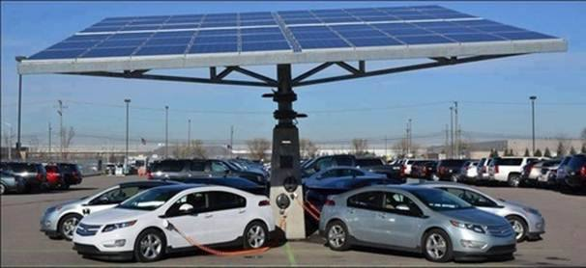
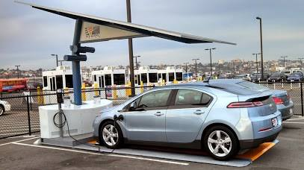
Railway station for electric car

Slide 31
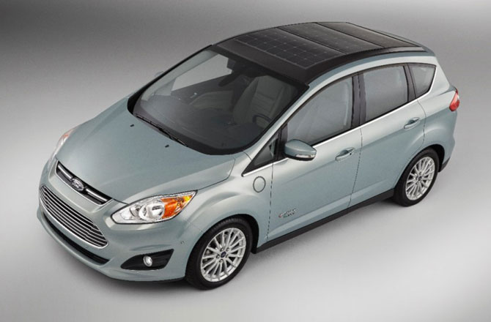
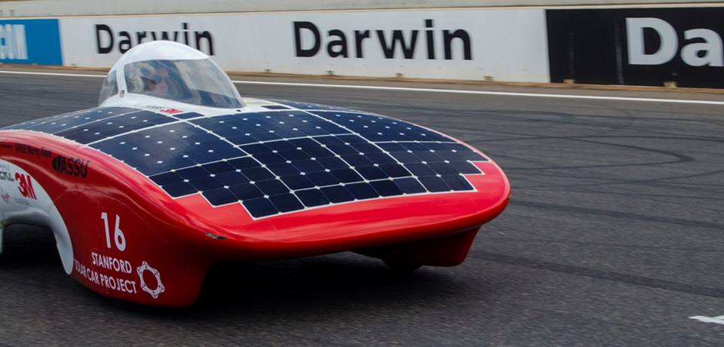
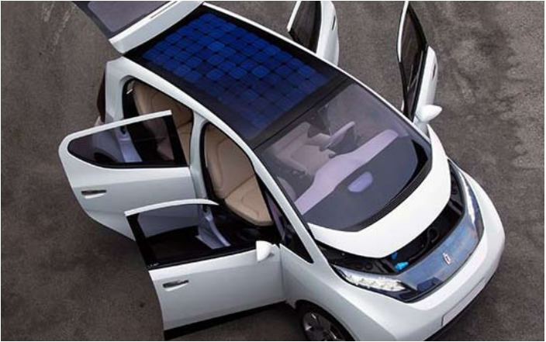
Electric car with PV

Slide 32
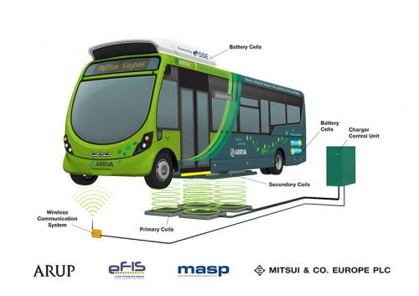
Electric bus charge wireless charging

Slide 33
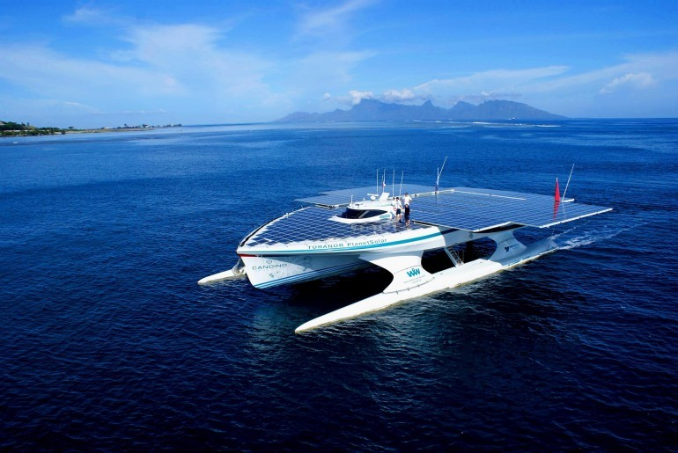
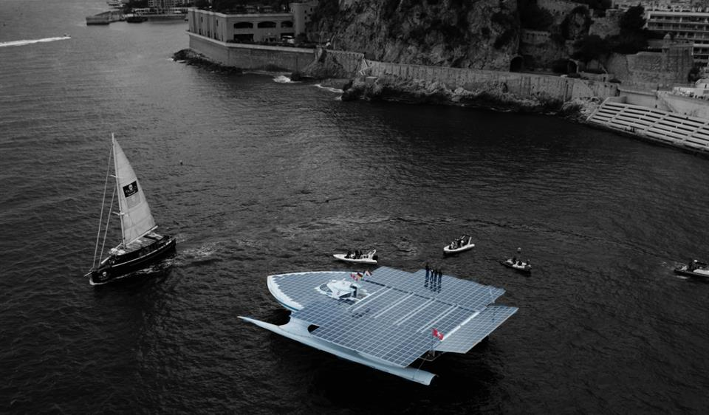
Electric ship with PV

Slide 34
Electric submarine with PV

Slide 35
Electric plan ( solar impulse ) with PV

Slide 36
Satellite with PV

Slide 37
Mars exploration by robot

Slide 38
Photovoltaic in the moon in the future ( Jaban ) :P

Slide 39
Street with photovoltaic

Slide 40
End of session
Facebook: www.facebook.com/abdo.fargly Email: engabdo.fargly@gmail.com
Edit by Eng. Abdelrahman Mohamed fargly

Slide 41
Question and discussion
Facebook: www.facebook.com/abdo.fargly Email: abdo_fargly@yahoo.com
Edit by Eng. Abdelrahman Mohamed fargly

